Slide 1
IT 1724 Geographical Information Systems
Prof. HKD Sarma
Department of IT, SMIT

Slide 2
OBJECTIVE: To introduce the concepts, principles and theories behind a Geographic Information System with emphasis on the nature of geographic information, data models and structures for storing geographic information; Geographic data input, data manipulation, and spatial analysis and modeling techniques are to be understood.
Text Book:
An Introduction to Geographical Information Systems, Ian Heywood, Sarah Cornelius, Steve Carver, 2010, Pearson Education.

Slide 3
What is spatial data ? →Spatial data, also known as geospatial data, is a term used to describe any data related to or containing information about a specific location on the Earth's surface.
→ Geographical Information Systems (GIS) and Geospatial Data are in the core of this study.

Slide 4
Need to Answer various Questions about….
Location…
Patterns…
Trends…
Conditions…

Slide 5
GIS is useful here…..
Location:
→ Where is the nearest book shops?
→ Where are stone age settlements located in Europe?
→ Where are areas of forestry in which Rudrakhs trees are found?
Patterns:
→ Where do high concentrations of students live in the city?
→ What is the flow of traffic along this motorway?
→ What is the distribution of crime incidents in New Delhi?

Slide 6
GIS is useful here…..
Trends:
→ How are patterns of retailing changing in response to the development of out-oft-town superstores?
→ Where have glaciers retreated in the European Alps?
→ Where have changes to the population of polar bears occurred?

Slide 7
GIS is useful here…..
Conditions:
→Where can I find holiday accommodation that is within 1 km of a wind surfing beach and accessible by public transport?
→ Where is there flat land within 500 m of a major highway?
→ Where are there over 1 00,000 potential customers within a 5 mile radius of a railway station?

Slide 8
Defining GIS
Definitions of GIS cover three main components:
→GIS is a computer system
→GIS uses spatially referenced or geographical data, and
→GIS carries out various management and analysis tasks on these data including their input and output.

Slide 9
Capabilities of well-designed GIS:
Quick and easy access to large volume of data
The ability to:
→select detail by area of theme
→link or merge one data set with another
→analyse spatial characteristics of data
→search for particular features in an area
→update data quickly and cheaply
→model data
3. Output capabilities tailored to meet particular needs.

Slide 10
Components of a GIS:
→ Computer systems and software
[High power processor/sufficient memory/high resolution colour graphics screen/data input and output devices.]
→Spatial data
→Data management and analysis procedure
→People / Organizations

Slide 11
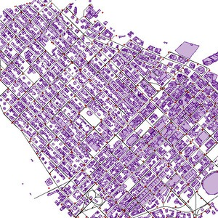
Spatial Data: Maps and their influence

Slide 12
Vector
Vector data is best described as graphical representations of the real world. There are three main types of vector data: points, lines, and polygons. Connecting points create lines, and connecting lines that create an enclosed area create polygons.
Vectors are best used to present generalizations of objects or features on the Earth’s surface. Vector data and the file format known as shapefiles (.shp) are sometimes used interchangeably since vector data is most often stored in .shp files.

Slide 13
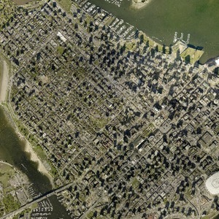
Raster data is data that is presented in a grid of pixels. Each pixel within a raster has a value, whether it be a colour or unit of measurement, to communicate information about the element in question. Rasters typically refer to imagery. However, in the spatial world, this may specifically refer to orthoimagery which are photos taken from satellites or other aerial devices. Raster data quality varies depending on resolution and your task at hand.

Slide 14
Spatial Data
Primary Data Sources
Daily Meteorological Records
Demand for skiing on different days of a week (no. of lift passes sold)
Secondary Data Sources
Meteorological Maps
Local Topographic Maps

Slide 15
Maps and their influence on the character of spatial data
Tasks of cartographer:
→Establish the purpose the map is to serve.
→Define the scale at which the map is to be produced
→Select the features (spatial entities) from the real world which are to be portrayed on the map.
→Choose a method for the representation of the features (points, lines, and areas).
→Generalize these features for representation in two dimensions.
→Adopt a map projection for placing these features onto a flat piece of paper.
→Apply a spatial referencing system to locate these features relative to each other.
→Annotate the map with keys, legends and text to facilitate use of the map.

Slide 16
Spatial Referencing
→A referencing system is used to locate a feature on the Earth’s surface or a two-dimensional representation of this surface such as a map.
→ Characteristics that a referencing system should have:
→ stability,
→ ability to show points, lines and areas,
→ ability to measure length, size (area) and shape.
CATEGORIES of Spatial Referencing:
→ Geographic co-ordinate systems
→ Rectangular co-ordinate systems
→ Non-co-ordinate systems

Slide 17
Geographic co-ordinate systems
→True geographic co-ordinates are latitude and longitude.
→ The location of any point on the Earth’s surface can be defined by a reference using latitude and longitude.
→ Lines of longitude (also known as meridians) start at one pole and radiate outward until they converge at the opposite pole.
→ Conceptually, they can be thought of as semicircles.
→ The arbitrary choice for a central line of longitude is that which runs through the Royal Observatory in Greenwich in England, and hence known as the Greenwich meridian or the prime meridian.

Slide 18
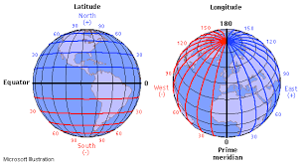
Longitude & Latitude

Slide 19
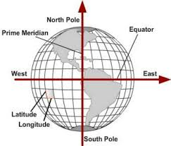
Longitude & Latitude

Slide 20
Geographic co-ordinate systems
→ Lines of longitude are widest apart at the equator, and closest together at the poles.
→ Lines of latitude lie at right angles to lines of longitude and run parallel to one another.
→ Each line of latitude represents a circle running around the globe.
→ Each circle will have a different circumference and area depending on where it lies relative to the two poles.
→ The circle with the greatest circumference is known as the equator (or central parallel), and lies equidistant from the two poles.

Slide 21
Geographic co-ordinate systems
→ Using lines of latitude and longitude, any point on Earth’s surface can be located by a reference given in degrees and minutes.
→ For example, the city of Moscow, represented as a point can be given a geographical reference using latitude and longitude of 55 degrees 45 minutes north (north of the equator) and 36 degrees 0 minutes east (east of the prime meridian).

Slide 22
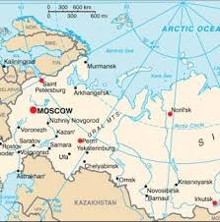
Geographic co-ordinate systems

Slide 23
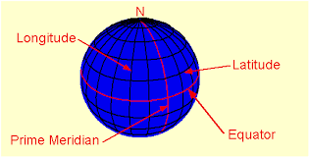
Longitude & Latitude

